Slide 1
PSFD PRoject
TEAM:-
S.J SUMANTH(2010030377)​
K.SREEVARUN(200030451)​
E. PAVAN SAI(2010030538)​
E. SHIVA GOUD(2010030542)​

Slide 2
Handwritten Digit Recognition using Python
REFERENCE: Deep Learning Project - Handwritten Digit Recognition using Python - DataFlair (data-flair.training)

Slide 3
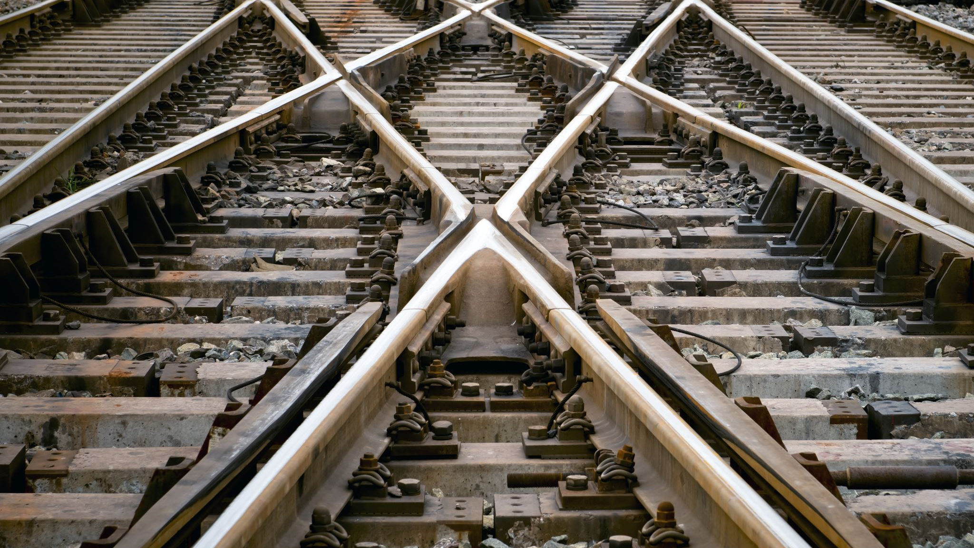
Outline
Abstract
Introduction
Literature Survey
Existing System and Proposed System
Algorithm
Implementation
Results
Conclusion and Future work

Slide 4
Abstract
Optical Character Recognition (OCR) is a subfield of Image Processing which is concerned with extracting text from images or scanned documents.
An OCR system depends mainly on feature extraction, recognition and classification into appropriate labels.
In this project, we have chosen to focus on recognizing handwritten digits with at most accuracy.
The challenge in this project is to use CNN algorithm, in order to maximize the accuracy of predicting the handwritten digits.

Slide 5
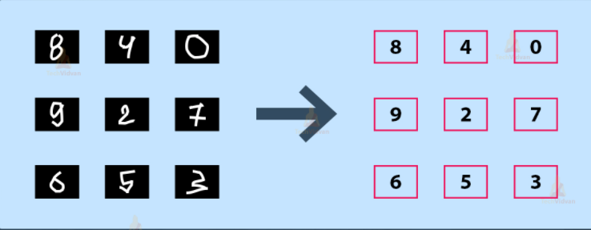
Introduction
It is easy for the human brain to process images and analyze them. When the eye sees a certain image, the brain can easily segment it and recognize its different elements. The brain automatically goes through that process, which involves not only the analysis of this images, but also the comparison of their different characteristics with what it already knows in order to be able to recognize these elements. There is a field in computer science that tries to do the same thing for machines, which is Image Processing.
Image processing is the field that concerns analyzing images to extract some useful information from them. This method takes images and converts them into a digital form readable by computers, it applies certain algorithms on them, and results in a better-quality images or with some of their characteristics that could be used in order to extract some important information from them.

Slide 6
Literature Survey
s.no | Title | Author | Journal and year | scope
1 | Handwritten Digit Recognition: A Neural Network Demo | erend Jan van der Zwaag | Research Gate --2001 | Improved detection in digits
2 | Handwritten Digit Recognition using Machine and Deep Learning Algorithms | Ritik Dixit, Rishika Kushwah, Samay Pashine | opensource -2021 | Improvement using deep learning algo
3 | Recognition of Handwritten Digit using Convolutional Neural Network in Python with Tensorflow and Comparison of Performance for Various Hidden Layers | Fathma Siddique, Shadman Sakib , Md. Abu Bakr Siddique | Opensource -2018 | Recognition using cnn neural networks
4 | Offline Handwritten Digits Recognition Using Machine learning | Shengfeng Chen, Rabia, Almamlook, Dr. Lee wells | ICIE -2018 | Without internet connection working

Slide 7

Existing system &PROPOSED SYSTEM
In the existing system have GUI interface for recognizing the digit
We have used flask web frame to develop an interface for our project.
We have improved our accuracy for digit recognition.
Our interface is easy to operate and user friendly .

Slide 8
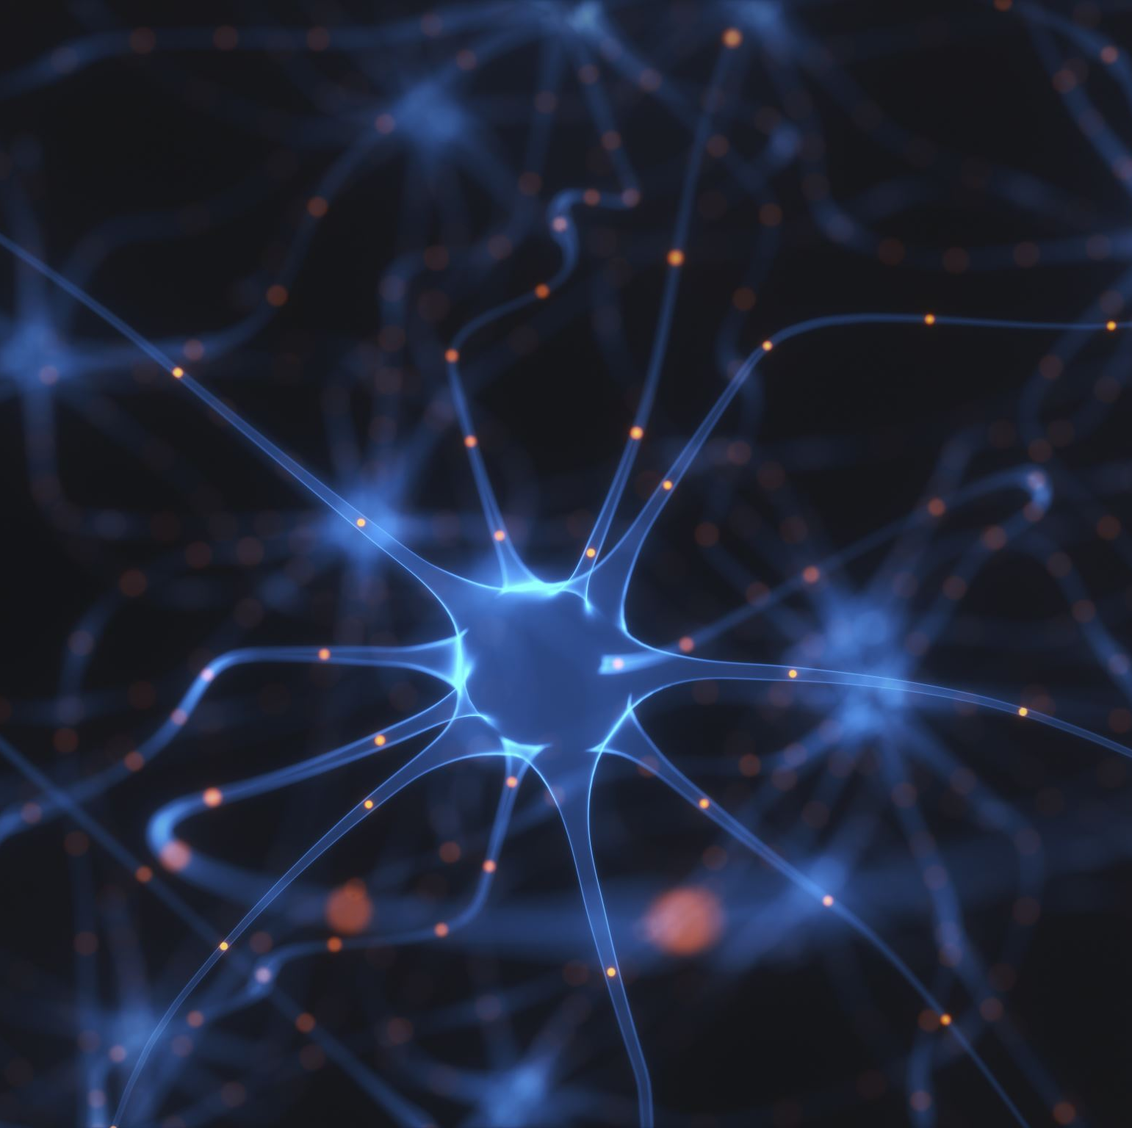
Algorithm: Convolutional Neural Networks
A Convolutional Neural Network
(ConvNet/CNN) is a Deep Learning algorithm which can take in an input image, assign importance (learnable weights and biases) to various aspects/objects in the image and be able to differentiate one from the other.
CNN utilizes spatial correlations which exist with the input data. Each concurrent layer of the neural network connects some input neurons.
This region is called a local receptive field. The local receptive field focuses on hidden neurons.
The hidden neuron processes the input data inside the mentioned field, not realizing the changes outside the specific boundary.

Slide 9


Slide 10
Implementation

Slide 11


Slide 12


Slide 13


Slide 14


Slide 15

Results

Slide 16
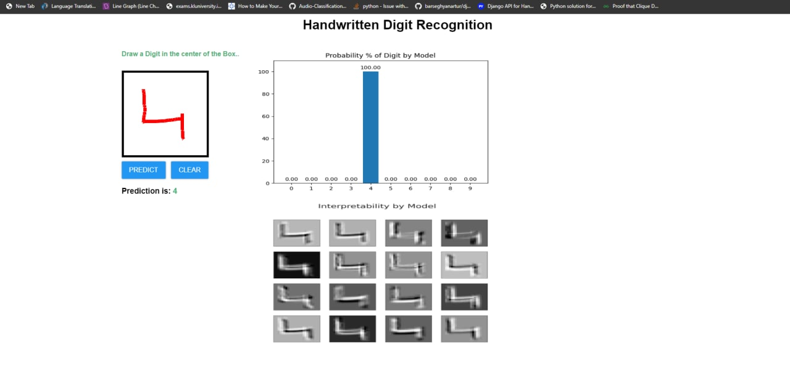

Slide 17
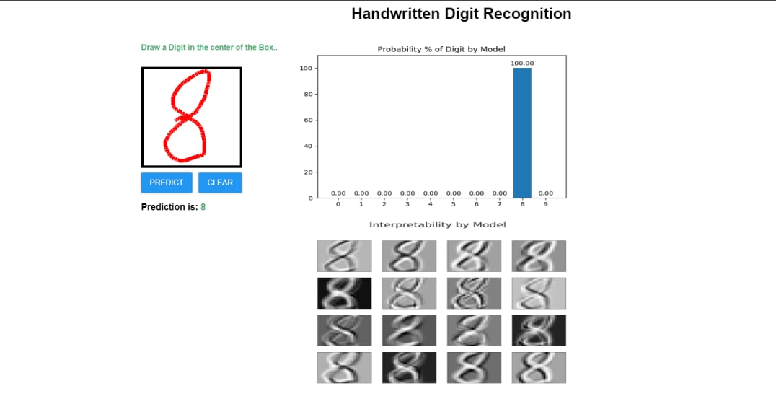

Slide 18
Applications
Detection of vehicle number
Banks for reading cheques
Post Offices for arranging letters

Slide 19

Conclusion and future work
Several OCR systems were studied and accurate methods, techniques were analyzed. OCR is a challenging area of research and introduces new challenges with its changing dynamics.
The most widely used Machine learning algorithm i.e CNN will be trained and tested on the same dataset in order acquire the comparison between the classifiers. Utilizing these deep learning techniques, a high amount of accuracy can be obtained
In future we want to develop alphabet recognizing system.

Slide 20


